Slide 1
ISTA131
Final Project
Ezio Dai

Slide 2
Data Source
2018 Chicago DIVVY bikeshare
https://docs.google.com/spreadsheets/d/1t4wJXlT2-P7djUjlK2FziedSrCsxtjTFHRD4mkqfvfo/gviz/tq?tqx=out:csv

Slide 3
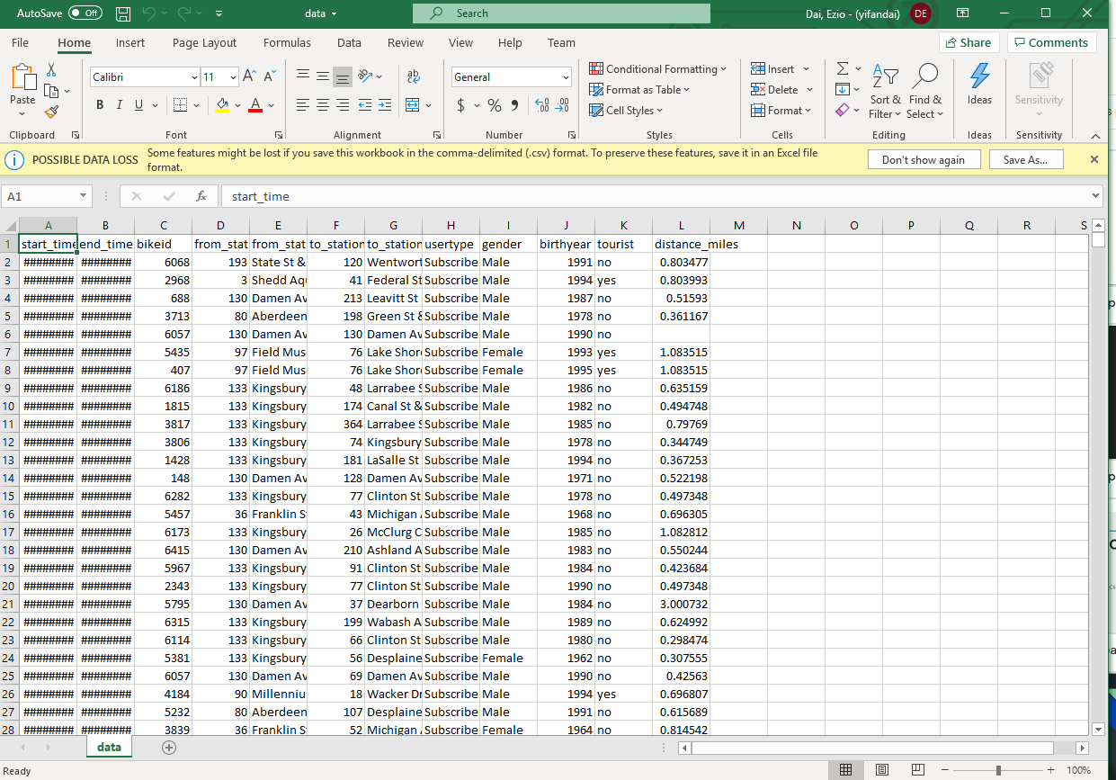
How the data looks like

Slide 4
What are we looking for?
The distribution of gender based on usertype.
The distribution of age based on usertype.
The relationship between age, gender & distance_miles.

Slide 5
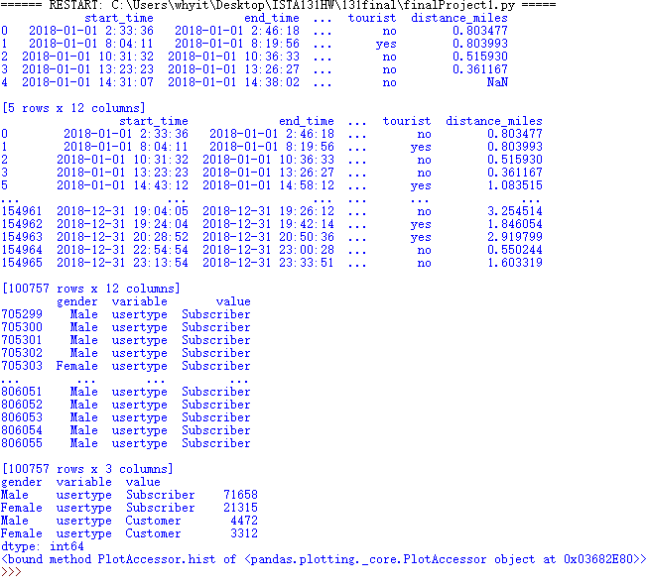
The Distribution of Gender Based on Usertype

Slide 6
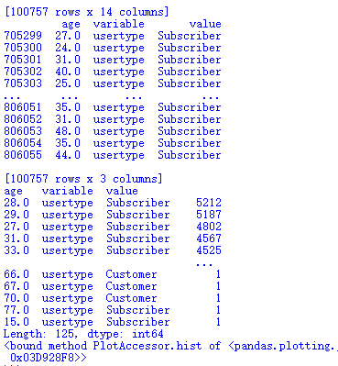
2. The Distribution of Age Based on Usertype

Slide 7
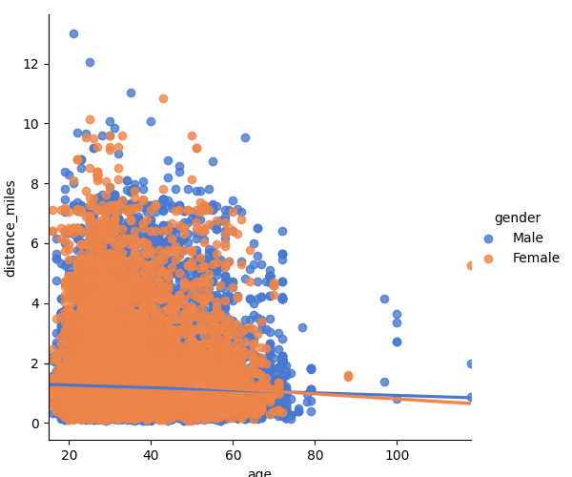
3. The Relationship of Age, Gender & Distance

Slide 8
Conclusion
The distribution of gender based on usertype.
Male is far more than female, especially in subscribed users.
The distribution of age based on usertype.
Most of users are under 60, it’s only a few elders that over 80 years old.
The relationship between age, gender & distance_miles.
Males are biking further in most conditions, and youth are biking further than elders.

Slide 9
End
Thanks for Watching

